Slide 1
London Boroughs and Crime
Coursera Capstone Project

Slide 2
Introduction
London, the largest of England, has diverse range of people and cultures. London has 32 districts, commonly known as London Boroughs. As a resident of this city, I decided to use London in my project.
In this project, I explore the different boroughs and the total crimes in the areas. Such information is always useful for people looking to relocate to London. We always tend to see the safer areas to raise our family.
Further I explore the neighborhoods in the safest borough and cluster the neighborhoods using K-means clustering.

Slide 3
Questions to answer
What is the safest borough?
What are the neighbourhoods in the safest borough?
These questions are important for those moving to London and looking for areas that are safe for their family, especially their kids.

Slide 4
Data
I have used the data from https://data.london.gov.uk/dataset/recorded_crime_summary. The data provides the number of crimes in each borough and the various crime categories between June 2017 to May 2019. A csv file was provided in the website.
I have scraped the geographical co-ordinates of the London Boroughs from https://en.wikipedia.org/wiki/List_of_London_boroughs using Beautiful soup.
I used Foursquare API to get the most common venues of the safest borough of London.

Slide 5
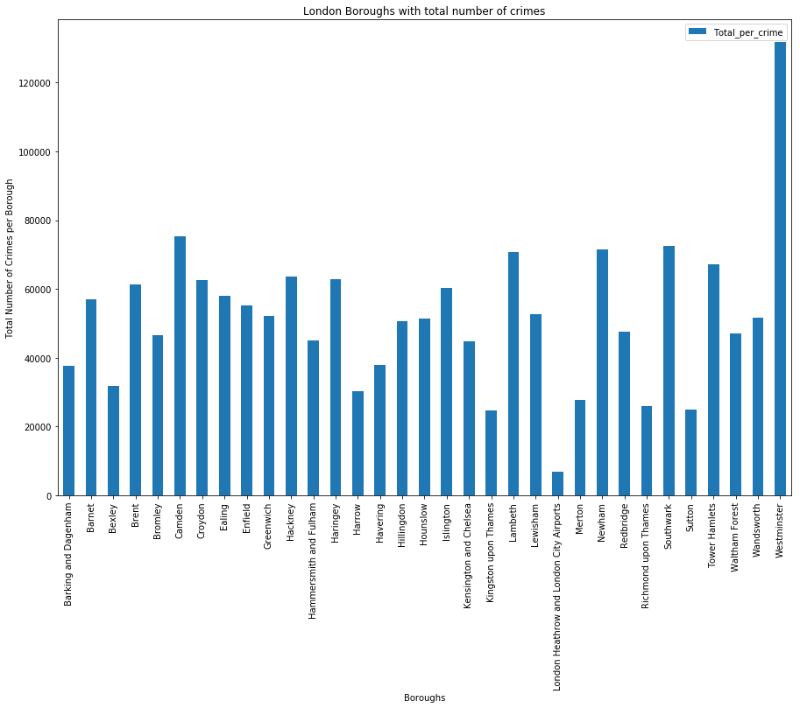
Crimes in the boroughs (June 2017 – May 2019
From the graph, it is seen that the least number of crimes is in London Heathrow and London City Airports. However, they cannot be considered for living.
Kingston upon Thames is the safest borough with the least number of crimes.
Westminster has the highest number of crimes.

Slide 6
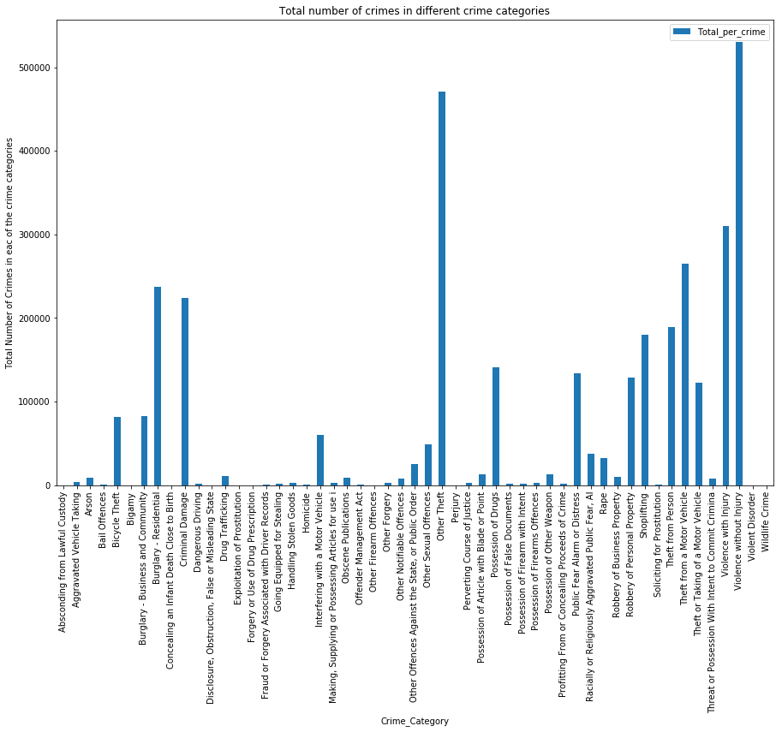
Crime CATEGORIES (June 2017 – May 2019
Highest crimes are in the category of Violence without injury.
Least number of crimes are in the category wildlife crime and violent disorder.

Slide 7
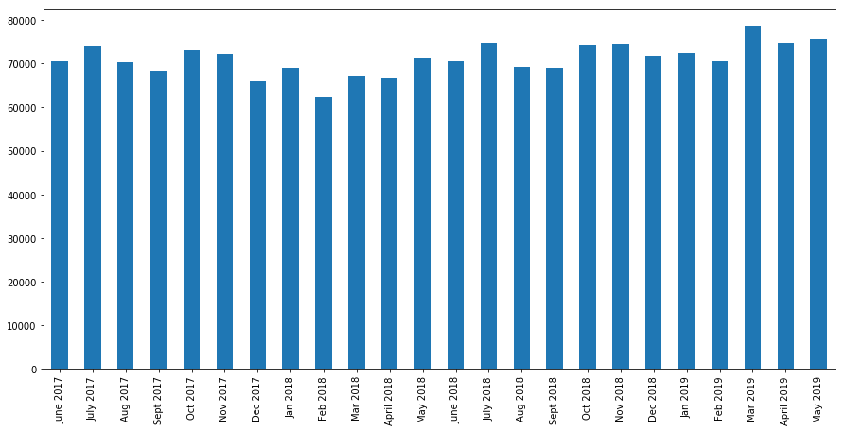
Number of crimes in the months JUNE 2017 TO MAY 2019
Maximum number of crimes between June 2017 to May 2019 was reported in March 2019.

Slide 8
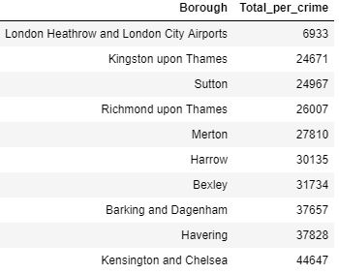
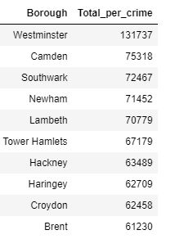
10 Boroughs with least number of crimes
10 Boroughs with Maximum number of crimes

Slide 9
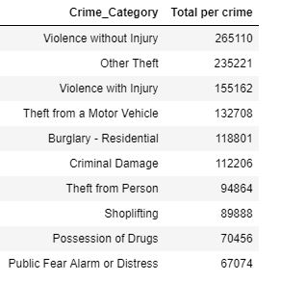
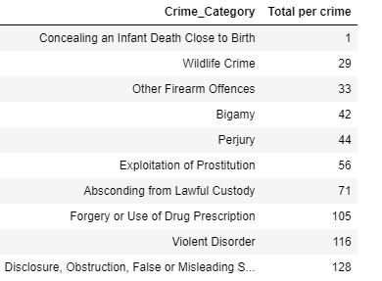
10 MOST COMMONLY OCCURRING crimes
10 LEAST COMMONLY OCCURRING crimes

Slide 10
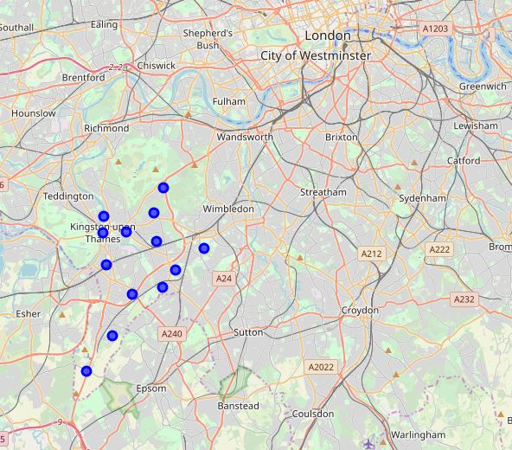
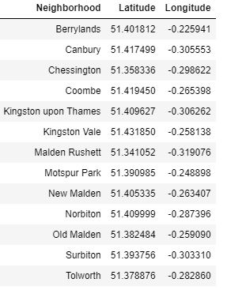
Neighborhoods of Kingston Upon Thames (The safest borough)

Slide 11
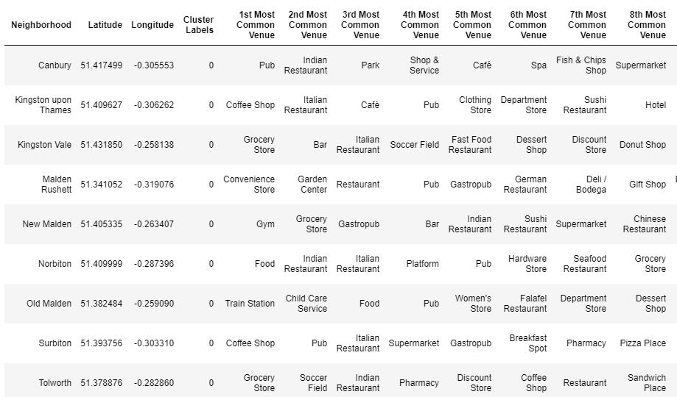
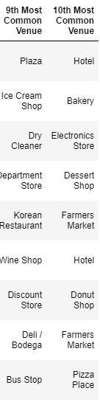
Clusters of KINGSTON UPON THAMES

Slide 12
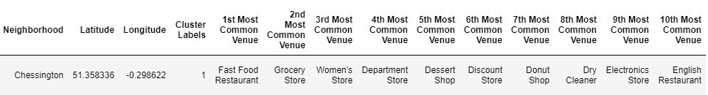
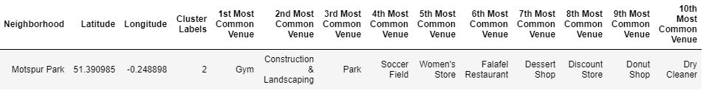
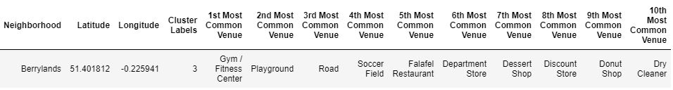
Clusters of KINGSTON UPON THAMES

Slide 13
Results and CONCLUSIONS
This project will be useful for those considering to relocate to London. It will make it easy to choose the safest borough in London. For a family, cluster 0 with the train station, park seems to be appropriate. The clusters show the common venues in the neighborhood.
In this project, I have considered only the safety factors, but other factors such as the cost of living, the quality of schools and many more could be considered. I also feel probably developing a model or an app where you can enter the name of a borough and get all the information when you click on various tabs such as transport, schools, restaurants etc.

